Slide 1
Emerging market multinational companies‘ evolutionary paths to building a competitive advantage from emerging markets to developed countries
Masaaki Kotabe & Tanvi Kothari
2016
Hoang Thi Binh Minh
2EC19015S
July, 2020

Slide 2
CONTENT
Introduction
Literature review
Research methods
Factors that affect the EMNCs’ competitive advantage
Conclusion

Slide 3
Introduction
Emerging Market Multinational Companies (EMNCs) have recently shown an unprecedented increase in numbers. Firms based in emerging markets is predicted to grow up to 45 per cents by 2025 (CNBC News, 2013).
Since 2000, substantial FDI from EMNCs has been targeted toward developed markets (OECD, 2006) in both resource industries and higher-value adding activities. (Aulakh, 2007; Bartlett & Goshal, 2000; Cuervo-Cazurra & Genc, 2008; Ramamurti & Singh, 2009).
Despite the disadvantages of being late entrants, EMNCs like Tata Motors, Lenovo, and Natura still succeed in developed-country markets.

Slide 4
Introduction
The authors focus specifically on the question of how the EMNCs build their competitive advantage from home markets to developed-country markets over time. To figure it out, they conduct a historical longitudinal analysis of sixteen successful EMNCs that originated from emerging markets like India and China through 59-year time period from 1950 to 2008.
They identify the various factors that influence the EMNCs’ competitive advantage in their home and host markets and how these EMNCs have been successful in transitioning from their developing market home nations to developed-country host markets. The results of this inductive approach suggest EMNCs’ paths to building competitive advantage in the developed countries

Slide 5
2. Literature review
Scholars have identified some of the following factors that influence the competitive advantage of organization include Dynamic Capability, Knowledge, Knowledge Management, Knowledge Sharing, Innovation Capability, Human Resource Management, New Product and/or Service Development, Intellectual Capital, Supply Chain, Information Technology.
In this paper, the authors do not intend to offer an exhaustive explanation of all the factors influencing the EMNCs’ competitive advantage. They propose whether key conditions affecting the EMNC will lead (or not) to firm-level competitive advantage.

Slide 6
3. Research methods
Multiple-case historical analysis: conducted an in-depth historical analysis of sixteen EMNCs equally representing seven industries from the two largest emerging markets: India and China; eight companies from each country and at least two cases belonging to the same industry in the particular country.
Qualitative principle of purposeful sampling, using the following criteria to select the EMNCs:
The companies are publicly traded on either the Indian or Chinese stock markets;
The EMNC is at least 15 years old;
At least two companies in each industry that originated from the same nation;
Successful companies in their industry and nation
Each EMNC has at least entered one major foreign market, namely the U.S

Slide 7
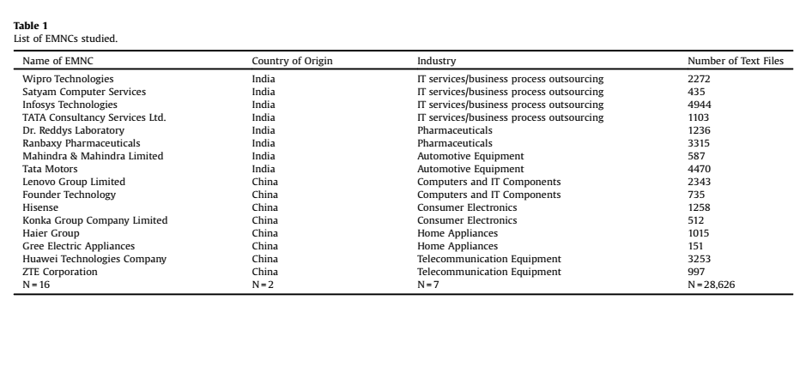
3. Research methods

Slide 8
3.1. Data analysis
Quantitative text-analysis, often referred to as content analysis, through 59-year timeline and the sheer quantity of documents (28,626 articles).
Method of computer-assisted, network-based text analysis called Centering Resonance Analysis (CRA) (Corman Kuhn, McPhee, & Dooley, 2002). CRA is a bundle of techniques, which transforms the structure of natural occurring text into a semantic network (Corman et al., 2002).
‘Crawdad Desktop’, a computer software program based on the grounded theory techniques of Strauss and Corbin (1990).

Slide 9
4. Factors that affect the EMNCs’ competitive advantage
Through the rich qualitative analysis afforded by historical analysis, a summary of the various factors and the EMNCs affected by them over time are:
Innovation capabilities
Knowledge sharing and organizational learning,
Marketing capabilities,
Cash rich positions,
Strategic partnership with MNCs

Slide 10
4.1. Stage I: Innovation capabilities 4.1.1. Innovation capabilities leading to competitive advantage in home countries
EMNCs’ transition from cost-based to differentiation-based competitive advantage as they transition into developed countries. Evidence from 16 cases suggests that EMNC innovation can be characterized as: Incremental in nature, Process-based, Shop floor-situated, Design and development dominated. (MNCs innovation is product-based like R&D).
To cope with the various constraints posed by their institutional environments such as price-conscious demanding customers, crowded factor markets, lack of essential resources, infrastructure, corrupt governments
The centralization aspects of the government policies, such as controlling FDI, controlling EMNCs’ ability to raise foreign capital or acquire foreign firms, lack of intellectual property protection
Both China and India opened up their nations to foreign firms
→ EMNCs are forced to innovate for their survival.

Slide 11
4.1.1 Innovation capabilities leading to competitive advantage in home countries
In 1945, Western India Products Limited (Wipro) produced vegetable oil. To overcome regulatory barriers that disabled them from purchasing the products from outside the country, Wipro expanded into the Infotech arena in the early 1980s.
Zhongxing Semiconductor Co., Ltd. (the former ZTE Corporation) established in 1985 in China. With a R&D team with eight members in 1987, the company has become China’s largest listed telecommunications equipment manufacturer and the fastest-growing telecommunication manufacturer in the world after 20 years. This is an evidence for EMNC’s capability to innovate to overcome the lack of infrastructure.

Slide 12
4.1.2 Innovation capabilities leading to competitive advantage in host countries
Introduce and market new products to developed market faster than their rivals
Diversify their vendor base, realize cost savings by off-shoring certain components, and retain flexibility to ramp up or scale down operations lockstep with changing business requirements.
The design competency of the EMNCs has become an important factor for its creativity.
Proposition 1. An EMNC’s capability to innovate to enhance their design competency and provide quality products forms an initial competitive advantage in the developed-country markets

Slide 13
4.2 Stage II Internal maturation
‘Knowledge Sharing & Organizational Learning’, ‘Marketing Capabilities’, and ‘Cash Rich Positions’ represent the second stage of EMNC’s competitive advantage development.
4.2.1 Organizational learning and knowledge sharing
Organizational learning and knowledge sharing in home countries
Organizational learning and knowledge sharing in host countries
4.2.2. Marketing capabilities
Marketing capabilities leading to competitive advantage in home markets.
Marketing capabilities leading to competitive advantage in host nations
4.2.3 Cash rich positions

Slide 14
4.2.1 Organizational learning and knowledge sharing
In home countries
EMNCs have partnered with institutes of higher education either to enhance their R&D skills or to overcome the institutional voids (weak educational system) to enhance their human capital. Since 1981, China developed postgraduate program with research projects. For instance, Konka Group set up an R&D center in cooperation with Beijing University of Posts and Telecommunications.
EMNCs’ interaction with the members of industry alliances. For instance, NASSCOM, India’s National Association of Software and Service Companies has created a global trade body with over 1100 members, of which over 250 are global companies from the U.S, the European Union, Japan and China. More than twenty Chinese firms, including EMNCs such as the Founder Group, Lenovo, Hisense, Haier, and Huawei founded an alliance called WAPI to reduce China’s reliance on foreign vendors (mainly U.S.)
→To learn and implement knowledge shared by trade associations
→Their membership in industry alliances and associations facilitates lobbying efforts with the government and enables creating an institutional environment that incubates innovation.

Slide 15
4.2.1 Organizational learning and knowledge sharing
b) In host countries
The model of original design manufacturer (ODM) was introduced: a global buyer first provides a local company a set of product ideas and/or concepts. The local company, in turn, designs the system, sources the components, and builds a product prototype.
For instance, IBM provided Lenovo a set of product ideas/concepts. Lenovo, in turn, designed the system, sourced the components, and build a product prototype according to these concepts. From that, the company could gain access and utilize different sources of technological knowledge and capabilities.
Proposition 2.
An EMNC’s capability to simultaneously use the exploration and
exploitation approach to learn and enhance its knowledge has a
positive relationship with its competitive advantage in the developed country markets.

Slide 16
4.2.2 Marketing capabilities leading to competitive advantages
In home markets
EMNC’s capability to market its products to demanding price-conscious consumers has a positive relationship with its competitive advantage in the home market.
For instance, Haier (founded in 1984, China) modified its product designs to accommodate the needs of the customers, overcome the challenges of specialized infrastructures, distribution channels, or delivery systems.
b) In host nations
EMNCs focus on niche opportunities that allow them to capitalize on their existing strengths.
Proposition 3.
An EMNC’s capability to find niche markets in developed-country
markets enhances its competitive advantage in those markets.

Slide 17
4.2.3 Cash rich positions
In order to expand to foreign nations, the EMNCs saunter different paths to enrich their cash positions.
For example, EMNC from India, Infosys Technologies Limited (1981) entered into a joint venture with an American consultancy firm called Kurt Salmon Associates (KSA) in 1987. The company became the first Indian company to be added to the NASDAQ-100 index.
Proposition 4.
An EMNC’s cash rich position facilitates its paths to build competitive advantage form home markets to developed country markets.

Slide 18
4.3 Stage III Strategic partnerships with developed country firms
a) In home markets
EMNC’s business ties with MNCs in the home market may have a U-shaped relationship with an EMNC’s competitive advantage in the home market. That means EMNCs’ competitive advantage tends to decline over time when their relationship with MNCs is informal, while the competitive advantage tends to improve if their relationship is formalized by the EMNCs.
b) In host markets
EMNCs continue to pursue selective strategic partnerships with (including acquisitions of) developed-country companies that will allow them to expand their product and service portfolio.
Proposition 5. An EMNC’s strategic partnership with, or acquisition of, developed-country firms to develop its technological or distribution capabilities further help enhance its previously developed capabilities and thus its competitive advantage in developed-country markets.

Slide 19
4.4. Observing a dynamic evolutionary process for the EMNCs’ development of competitive advantage
Key advantages that these EMNCs have are twofold. First, it is their access to some of the world’s most dynamic growth markets with global consumers, and second, it is an immense pool of low-cost resources, be the production workers, engineers, land. For instance, Infosys Technologies Ltd. has built a new Global Education Center in the southern Indian city of Mysore to be able to train its workforce. Thus, the EMNCs’ ability to access, attract, and retain skilled IT professionals has enhanced their ability to compete against the incumbent MNCs.
EMNC’s ability to simultaneously sell branded products or offer solutions to niche segments in developed countries (demand side) and capabilities to optimize low-cost resources in home markets (supply side) facilitates its paths to build competitive advantage form emerging markets to developed countries.

Slide 20
4.4. Observing a dynamic evolutionary process for the EMNCs’ development of competitive advantage
Key advantages that these EMNCs have are twofold. First, it is their access to some of the world’s most dynamic growth markets with global consumers, and second, it is an immense pool of low-cost resources, be the production workers, engineers, land. For instance, Infosys Technologies Ltd. has built a new Global Education Center in the southern Indian city of Mysore to be able to train its workforce. Thus, the EMNCs’ ability to access, attract, and retain skilled IT professionals has enhanced their ability to compete against the incumbent MNCs.
EMNC’s ability to simultaneously sell branded products or offer solutions to niche segments in developed countries (demand side) and capabilities to optimize low-cost resources in home markets (supply side) facilitates its paths to build competitive advantage form emerging markets to developed countries.

Slide 21
4.4. Observing a dynamic evolutionary process for the EMNCs’ development of competitive advantage
Key advantages that these EMNCs have are twofold. First, it is their access to some of the world’s most dynamic growth markets with global consumers, and second, it is an immense pool of low-cost resources, be the production workers, engineers, land. For instance, Infosys Technologies Ltd. has built a new Global Education Center in the southern Indian city of Mysore to be able to train its workforce. Thus, the EMNCs’ ability to access, attract, and retain skilled IT professionals has enhanced their ability to compete against the incumbent MNCs.
EMNC’s ability to simultaneously sell branded products or offer solutions to niche segments in developed countries (demand side) and capabilities to optimize low-cost resources in home markets (supply side) facilitates its paths to build competitive advantage form emerging markets to developed countries.

Slide 22
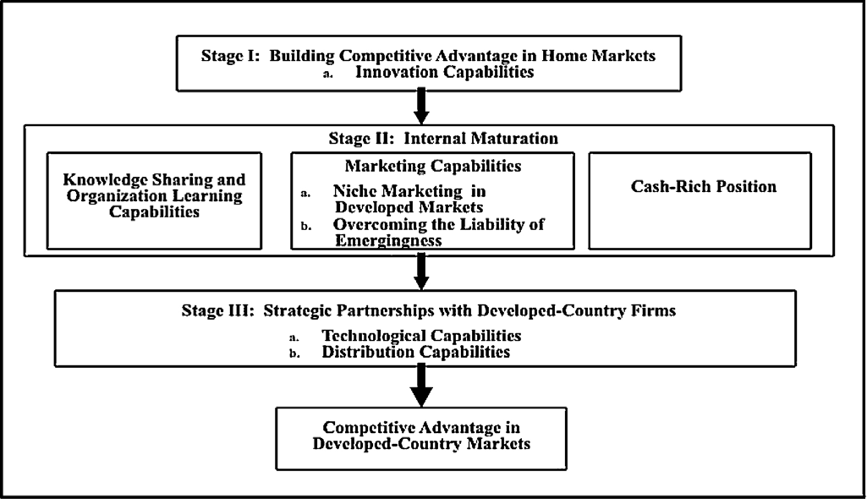
4.5. Framework to explain the paths of building EMNCs’ competitive advantage from home markets to developed countries.

Slide 23
4.5. Framework to explain the paths of building EMNCs’ competitive advantage from home markets to developed countries.
Difficult environmental conditions at home such as a weak institutional context, price-sensitive consumers, instead of acting as impediments, have helped EMNCs that to develop unique competencies to compete successfully in foreign markets.
EMNCs have been focusing on growth, even if this means lower profitability. They attempt to add new customers and continuously seek for new growth engines by adding new product and service lines.
EMNCs expand quickly by relying on partnerships and joint ventures, or take advantage of using R&D labs
The knowledge and experience gained through their relationships with the trade associations, institutions of higher education and MNCs in the home nations, combined with their cash-rich positions, enables them to enter into partnerships and sometimes even acquire firms from developed countries.

Slide 24
5. Conclusion
Knowledge is one of the most important factors influencing EMNCs competitive advantage.
To gain competitive advantages, EMNCs have to have capability to find a global market for their products on the demand side
EMNCs need a clear strategy and organizational confidence as well as a passion for learning to become a global player: EMNCs have pursued a set of innovative strategies. The first is developing breakthrough innovations for an individual emerging market, such as China or India. The second step is transferring these innovations selectively to developed-country markets.

