Slide 1
Expansion abroad and jobs at home： Evidence from Japanese multinational enterprises
Nobuaki
Yamashita & Kyoji Fukao
PRESENTAION BY DI FEI (2EC20225P)
Notes:
Good afrernoon everyone. This is FEI DI.
In the next 30 mintues, I will share my paper to you.
As an academic paper, it may be a little hard to understand.
But I will make may effort to simply my explanation as better as possible.

Slide 2
WHAT IS THIS PAPER MAINLY TAKING ABOUT?
‘ Exporting job ’hypothesis:
The expansion of overseas operations of manufacturing multinational enterprises (MNEs) will affect the home employment.
Vote:
What do you think about the effect??
Please write you answer at the comment board.
Thank you for your cooperation.
A. Reducing the home employment?.
B. Increasing the home employment?
C. either
Notes:
WHAT IS THIS PAPER MAINLY TAKING ABOUT?
The expansion of overseas operations of manufacturing multinational enterprises (MNEs) will affect the home employment.
It is called Exporting job ’hypothesis.
The debate over the possible adverse effects of overseas production by multinational enterprises (MNEs) on home employment (‘exporting jobs’) first emerged in the US in the late- 1960s (Kravis and Lipsey, 1988).
It had also become the subject of heated policy debate in Japan under the label of ‘manufacturing hollowing-out’ following the spread of production bases of Japanese MNEs to low cost countries in East Asia from the mid-1980s.
So.. What do you think about the effect??

Slide 3
What is special in this paper?_ (background introduce)
(Until 2010) No similar study has been undertaken for Japanese MNEs.
This paper filled this gap.
Differences from other paper
1. choose the firm-level dataset rather than the industry-leve
2.Covering divers scale of Japanese parent firms
Notes:
There has been a proliferation of empirical investigations of the exporting jobs hypothesis, using matched parent-affiliates datasets for MNEs of various national. However, to our best knowledge, until 2010 no similar study has been undertaken for Japanese MNEs. This paper filled that gap.
The available Japanese evidence on this subject is mainly drawn from the readily available industry-level FDI data
Since the FDI decision is made at the firm-level rather than the industry-level, the firm- level dataset allows us to undertake the first analysis for properly assessing the exporting jobs hypothesis for Japanese MNEs.
(actually)Head and Ries (2002) uses the firm-level data compiled from the Toyo Keizai which only includes the listed firms in the Japanese stock market in Japan. Instead, the dataset compiled for our paper cover divers scale of Japanese parent firms.

Slide 4
about The data
Period:
1991-2002
Source:
Japanese Ministry of the Economy, Trade and Industry (METI)
Target:
Japanese MNEs parent firms and their foreign affiliates and…
Notes:
The data is compiled from the unpublished returns to two annual enterprises surveys of Japanese MNEs parent firms and their foreign affiliates, the Basic Survey of Business Structure and Activity and the Basic Survey of Overseas Japanese Business Activity, collected by Japan Ministry of the Economy, Trade and Industry (METI) over the period 1991–2002.
The analysis of this paper is based on estimating labour demand of parent firms controlling for the firm attributes and specific regional characteristics of overseas operation of MNEs.

Slide 5
The paper’s main purpose
10 percent+
leads to
0.2 percent+
‘exporting job hypothesis’.
Notes:
The findings of this paper do not support the ‘exporting job hypothesis’. Instead, there is some evidence of complementary relationship between employment in foreign affiliates of MNEs and their home employment; a 10 percent increase of foreign affiliate employment leads to a 0.2 percent increase in home employment.

Slide 6
Pre analysis 1
The effect of the overseas operations on domestic operations of MNEs :
1.Actually…
Due to the scale effect
Positive
Negative
The correction necessary to apply to measurements made on a model in a wind tunnel in order to deduce corresponding values for the full-sized object.
Notes:
1.It is equally possible that increased overseas operations might enhance the scale of home economic activity due to better resource allocations and the expanded overseas market (the scale effect).
so
The net impact of increased overseas operation on home economic activity can be either positive or negative, depending on the magnitude of the scale and the substitution effects

Slide 7
Pre analysis 2
2.Two types of MNEs: A. vertical B. horizontal
A. vertical : Taking the advantage of the existence of international factor price differentials
So…employment can be substitutes
However… Domestic operation maybe expanded Enhanced production efficiency of vertical specialization.
B. Horizontal
Little effect or Even expanding
Notes:
The net effect of overseas operation can also vary among different types of MNEs. In general, the theory postulates two types of MNEs, depending on the investment motivation: vertical or horizontal.
The A type of MNEs vertically separate the production process between parent MNEs and their foreign affiliates. MNEs of this type are usually motivated to take advantage of the existence of international factor price differentials between home and host-country.
In this case, overseas and domestic employment can be substitutes, since some domestic operations are directly relocated to overseas locations.
However, it is possible that the domestic operation is expanded due to the enhanced production efficiency of vertical specialization.
In B type, expanded overseas operations may either have little effect on the scale of the domestic operation of MNEs or their domestic operations may even expand due to the expanded worldwide scale of production.

Slide 8
Pre analysis 3
Beyond...
1.the location of overseas operations : Developed or Developing countries
2. Owing the plant-level or firm-level economies of scale.
Notes:
Beyond this theoretical classification of MNE types, the postulated relationship between overseas and domestic employment might also depend on the extent to which overseas operations are located in developed as opposed to developing countries, and also whether foreign affiliates have plant-level or firm-level economies of scale.

Slide 9
For examining: the empirical formulation(1)&(2)
The regression analysis is based on a reduced form of labour demand equation widely used in this strand of literature
Notes:
This part is quiet difficult to understand especially audiauce without the knowledge of statistics.
where subscripts i, h, and t denote parent firm, home country, and time. The dependent variable (L) is the quantity of home employment; w, Q, and r represent own-wage rate, output, and the price of capital; a proxies the unobserved features such as the parent’s level of technology and firm-specific capital. ln indicates natural logarithm. Hence, the log-linear specification offers the direct interpretation of elasticity between factors, holding the output constant (i.e., own-wage elasticity and cross-factor elasticity).
The labour demand equation (1) is expanded to incorporate variable capturing overseas operations of foreign affiliate of MNEs (denoted as MNE) and other relevant variables influencing the demand of labour by parent firms.

Slide 10
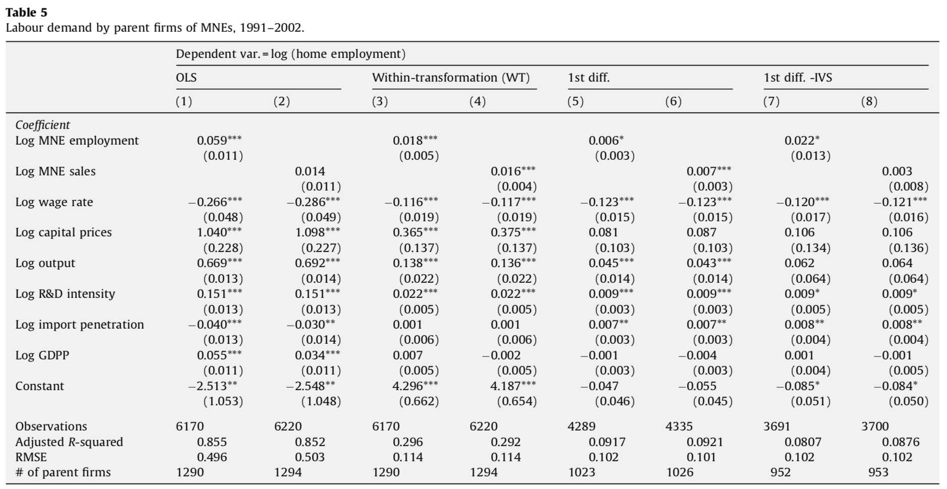
Notes:
The regression results for the labour demand equation (2) are reported in Table 5. In this table, Eqs. (1) and (2) report the estimation results based on OLS, and Eqs. (3) and (4) by within- transformation, Eqs. (5) and (6) by first-difference, and Eqs. (7) and (8) by instruments variable (IV) approach. Tables 6a–6d present results for each of the four regions—East Asia, North America, the EU and South America.
Model (3) (within-transformation) suggests a 10 percent increase of foreign affiliate employment leads to a 0.18 percent increase of home employment. MNEQ also indicates a statistically significant positive effect on home employment with the similar magnitude (Model (4)).
Further, foreign demand shocks, captured by GDP per capita, have no statistical relationship with change in home employment, apart from OLS results.
The first-difference estimator (Models (5) and (6)) in Table 5 also suggests a complementary relationship between overseas operations and home employment. However, the magnitude of the estimated coefficients for MNEQ and MNEL is significantly lower than reported for Models (3) and (4).
The IV procedure in Models (7) and (8) improves the results for foreign affiliate employment, but the correction of endogeneity for foreign affiliate sales loses the statistical significance of this variable.
The OLS result in Model (1) in Table 5 indicates a positive complementary relationship between foreign affiliates and home employment and the negative impact of foreign affiliate output on home employment. The evidence also indicates a positive impact of foreign market demand shock (GDPP) on home employment.

Slide 11
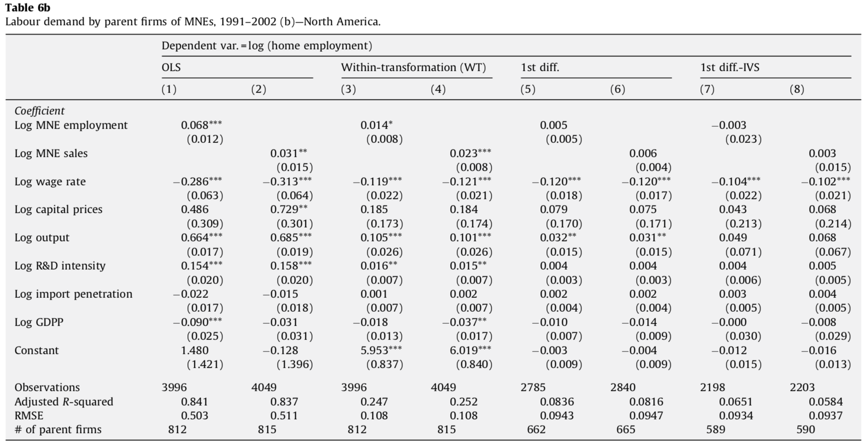
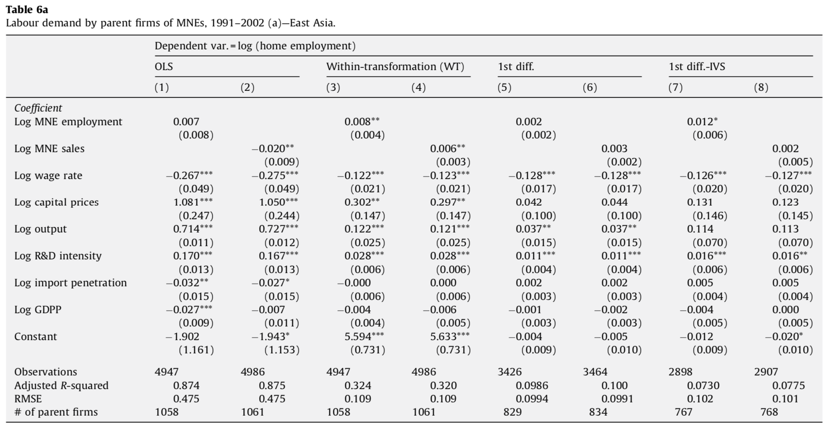
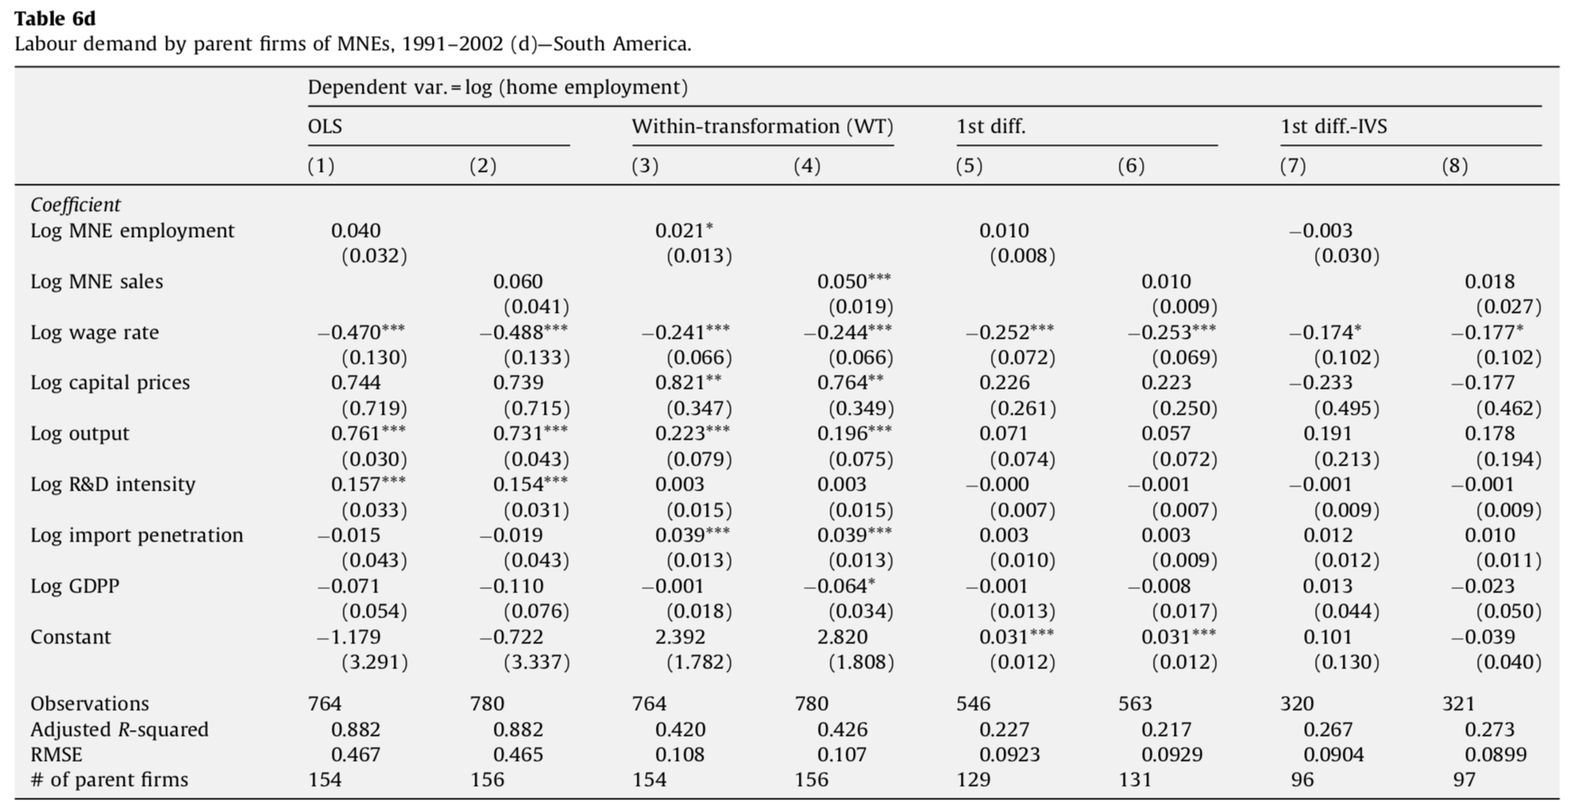
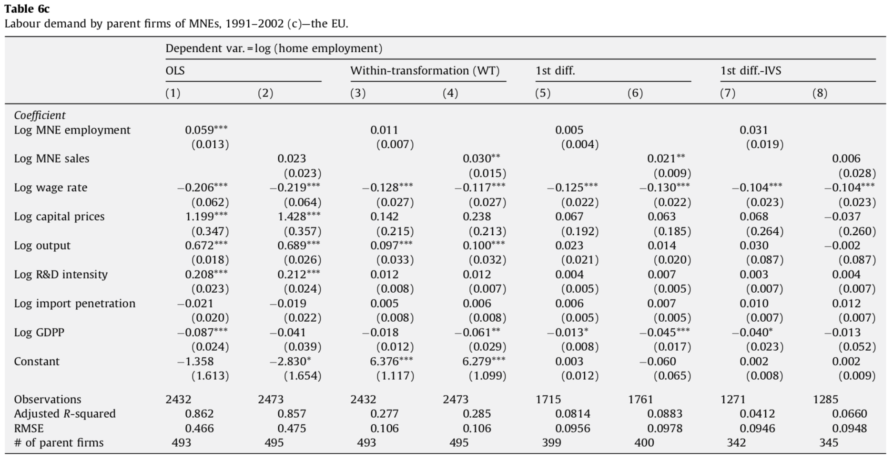
Notes:
Tables 6a–6d present results for each region, East Asia (Table 6a), North America (Table 6b), the EU (Table 6c) and South America (Table 6d). Even though Japanese MNEs have been actively operation in East Asia since the mid-1980s, its expansion in terms of employment and sales do not seem to negatively affect the level of home employment. In fact, foreign operations in East Asia seem to have little impacts on home employment.
In North America, foreign affiliates employment and sales have a positive impact (Model (3) and (4), Table 6b). However, the findings are sensitive to the estimation method. The similar inferences can be made for the EU (Table 6c).

Slide 12
Results form tables
I. Wage elasticity of labor
II. The estimated coefficient of r
Notes:
Overall, there is no clear-cut evidence of ‘exporting jobs’ by Japanese MNEs, despite the concerns expressed in the public debates. In fact, there is some weak evidence to suggest that expanded overseas operations may have actually helped to maintain the level of home employment.
Other determinants of labour demand by parent firms can be summarised as follows.
Wage elasticity of labour demand consistently has the expected negative sign, indicating a down- ward sloping of labour demand.
The estimated coefficient of r (the user cost of capital) shows mixed results, making it impossible to infer whether capital and home employment are substitutes for or complementary to each other.

Slide 13
Conclusion of this paper
Challenging the popular perception
Expanding overseas operations will..
enhancing their competitiveness and profitability
generating higher demand for more technology and skill intensive activities
Helping upgrade the skill intensity of the home production.
FINALLY
Notes:
This finding challenges the popular perception of MNEs ‘exporting jobs’ when they expand overseas operations.
The evidence suggests that expanded overseas operations by MNEs not only help firms to enhance their competitiveness and profitability but may also have a positive impact on home MNE employment by generating higher demand for more technology and skill intensive activities.
When the positive general equilibrium effects of profit remittances on overall home employment is also taken into account, there appears to be no case for any government action to restrain overseas expansion of Japanese MNEs.
Eventually this process will help upgrade the skill intensity of the home production.

Slide 14
Future talking
Problem
significant adjustment pressures during the transitional period
How to solve?
Investigating & addressing
Notes:
However, there will be a transitional period during which there is likely to be significant adjustment pressures on the MNE workforce at home as MNE home production is restructured to focus on production of more technology and capital intensive production process.
To reduce this significant adjustment pressures.
First,we should investigate the firm-level effects of this process to identify the adjustment problems faced by the existing MNE workforce
Secondly, addressing related assistance and labour retraining requirements.

