Slide 1

幻灯片 1
International Trade,
Multinational Activity,
and Corporate Finance

Slide 2
幻灯片 12
Contents
1. Introduction
2. Antecedents
3. International trade and corporate finance
4. Multinational activity and corporate finance
5. Conclusions and future research
2

Slide 3
幻灯片 12
1. Introduction
Much of this work on trade and foreign direct investment (FDI) pays little attention to corporate finance considerations and effectively assumes that firms can access the financial capital necessary to implement their first-best investment choices.
the finance literature has concentrated on companies that operate in a single country, and only some strands of this work draw attention to cross-country differences that affect firm decisions.
the section examines the types of financial contracts that support international trade. unique insights from the field of corporate finance are central to understanding international economic activity.
3

Slide 4
幻灯片 12
2. Antecedents
Theoretical models of firms’ motives for engaging in foreign investment, capital availability could play a role, but this possibility has traditionally not been examined in detail or through the lens of corporate finance.
Studies of international trade patterns generally exploit data on investment expenditures instead of firms’ financing practices to proxy for the total capital endowment in a country. Research on multinational activity tends to examine the endowments of input factors other than capital.
Traditional frameworks allowed a role for capital but typically considered physical capital that cannot move across borders.
4

Slide 5
幻灯片 12
2. Antecedents
Research that challenged the notion that firms are unconstrained in their ability to raise capital to fund investment and that highlighted the vibrant role of firms’ internal capital markets has provided key insights for understanding how access to finance might affect trade and multinational activity.
These Research indicate that local financial institutions might impede firms that are considering becoming exporters or investing abroad. Multinational firms might be well positioned to tap into international sources of finance through the use of internal capital markets.
The literature raises the possibility that while enterprises based in a single location are likely to be constrained by their domestic capital market conditions, corporations with affiliates in multiple countries might be able to use internal capital markets opportunistically.
5

Slide 6
幻灯片 12
3. International trade and corporate finance
3.1. Key Mechanisms
Frictions that inhibit access to financial capital can affect aggregate trade flows through three key channels: firm entry into domestic production, domestic producers’ entry into exporting, and exporters’ trade performance.
In a world with one homogeneous product and a differentiated-good sector with fixed costs, countries are not perfectly specialized, but financially advanced nations have a competitive edge in the sector with economies of scale.
Financially advanced countries thus have higher exports in industries that are financially more vulnerable because more firms are able to become exporters and because exporters realize higher trade flows.
Very productive firms therefore always trade, but some mid-productivity potential exporters cannot because of a low liquidity draw, and some low-productivity would-be domestic firms export because of a high liquidity shock.
6

Slide 7
幻灯片 12
3. International trade and corporate finance
3.2. Empirical Evidence
A common proxy for the degree of financial development is the amount of external capital available to producers. Financially advanced economies serve more destination markets and export more products, especially in financially more vulnerable sectors.
Credit constraints indeed become more stringent as firms’ export share grows, especially when shipping times are longer and working capital needs are therefore more acute.
In principle, crises may or may not affect cross-border trade more than total output. Isolated financial shocks in one country might equally disrupt its general production and exports. The decline in aggregate trade during financial crises is accompanied by sizable differences in performance across firms with varying access to capital.
7

Slide 8
幻灯片 12
3. International trade and corporate finance
3.3. International Trade Finance
A trading relationship can be a source of capital for firms in countries with poorly functioning institutions. Cross-country differences in contractual enforcement determine how the working capital requirements of trade are financed.
Bank-mediated letters of credit seem most valuable when neither trade party can easily bear the risks of the transaction. The manner in which short-term working capital needs are met has also been shown to shape the impact of crises on trading activity.
a corporate finance perspective is particularly valuable in understanding how firms meet the short-term working capital needs of international trade.
8

Slide 9
幻灯片 12
4. Multinational activity and corporate finance
Research on multinational firms has not traditionally studied the potential role of corporate finance considerations.
Tt is useful to point out at the outset that research illustrates the vibrancy of internal capital markets. Credit constraints can limit the extent of spillovers but that FDI can alleviate such constraints for local firms.
Findings indicate that multinationals exploit their internal capital markets in response to cross-country differences in the availability of capital and tax rates. The wedge between the cost of borrowing from external lenders and the cost of borrowing from parent companies is larger where credit markets are less developed, and affiliates in such countries borrow more from their parents.
The destination of subsidiary sales speaks to multinationals’ incentives to pursue horizontal, vertical, and export platform FDI, host-country financial development thus appears to jointly impact the incidence, level, and nature of multinational activity.
9

Slide 10
幻灯片 12
4. Multinational activity and corporate finance
4.1. Financing Fixed Costs
The destination of subsidiary sales speaks to multinationals’ incentives to pursue horizontal, vertical, and export platform FDI, host-country financial development thus appears to jointly impact the incidence, level, and nature of multinational activity.
related evidence that multinational firms exploit their internal capital markets opportunistically to overcome fixed trade costs that stand-alone domestic firms may not be able to.
10

Slide 11
幻灯片 12
4. Multinational activity and corporate finance
4.1. Financing Fixed Costs
The destination of subsidiary sales speaks to multinationals’ incentives to pursue horizontal, vertical, and export platform FDI, host-country financial development thus appears to jointly impact the incidence, level, and nature of multinational activity.
related evidence that multinational firms exploit their internal capital markets opportunistically to overcome fixed trade costs that stand-alone domestic firms may not be able to.
11

Slide 12
幻灯片 12
4. Multinational activity and corporate finance
4.2. Exploiting Relative Access to Capital
Multinational firms are often more able to obtain needed financial capital than are local firms, and this differential access to capital affects FDI patterns.
When external capital markets are imperfect, internal capital markets also play a central role in explanations of FDI based on relative wealth effects.
Crises provide a powerful setting to assess the importance of access to capital for multinational firm activity. Multinationals not only react more effectively to positive demand shocks than do native firms, but they also are more resilient to negative shocks to financial conditions.
12

Slide 13
幻灯片 12
4. Multinational activity and corporate finance
4.3. Responding to Governance Challenges
In environments with weaker investor protection and more costly external sources of finance, there is more scope for managerial misbehavior.
Developed countries with strong financial institutions tend to be net suppliers of FDI but attract significant net flows of financial capital, whereas the opposite often holds for developing countries with weak financial institutions.
13

Slide 14
幻灯片 12
4. Multinational activity and corporate finance
4.4. Spillovers
Strong local financial institutions facilitate the creation of firms that might be able to form backward linkages with foreign companies and enjoy any potential benefits of doing so.
Economic growth is more significantly impacted by FDI inflows in countries with well-developed financial markets.
14

Slide 15
幻灯片 12
5. Conclusions and future research
This article surveys research at the intersection of international economics and corporate finance. Recent work illustrates how international trade and multinational activity are affected by the credit constraints firms face and by firms’ ability to make use of internal capital markets.
This article does not discuss international tax issues, future research could also provide valuable insights about the aggregate effects of financial frictions on international activity.
Future research could also explore how credit constraints and the use of internal capital markets by multinationals impact the international transmission of shocks.
15

Slide 16
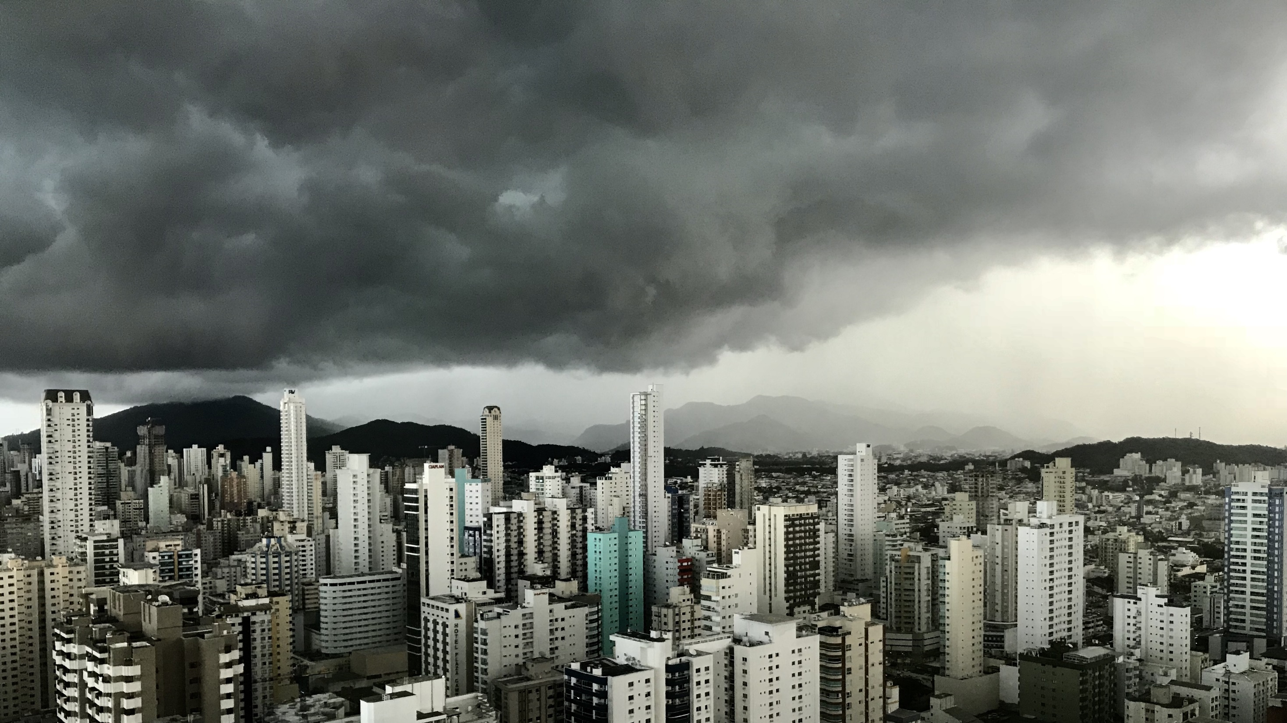
幻灯片 11
THANK YOU！

